Slide 1


Loan Application Analysis

Slide 2

Objective and Tools
Kaggle
Python
Snowflakes
Power BI
Dax

Slide 3

Data Cleaning
Data Types
Checking Missing Values
Checking Duplicates
Standardizing Data

Slide 4

Data Integration
Derived Columns

Slide 5

Visualizations

Slide 6

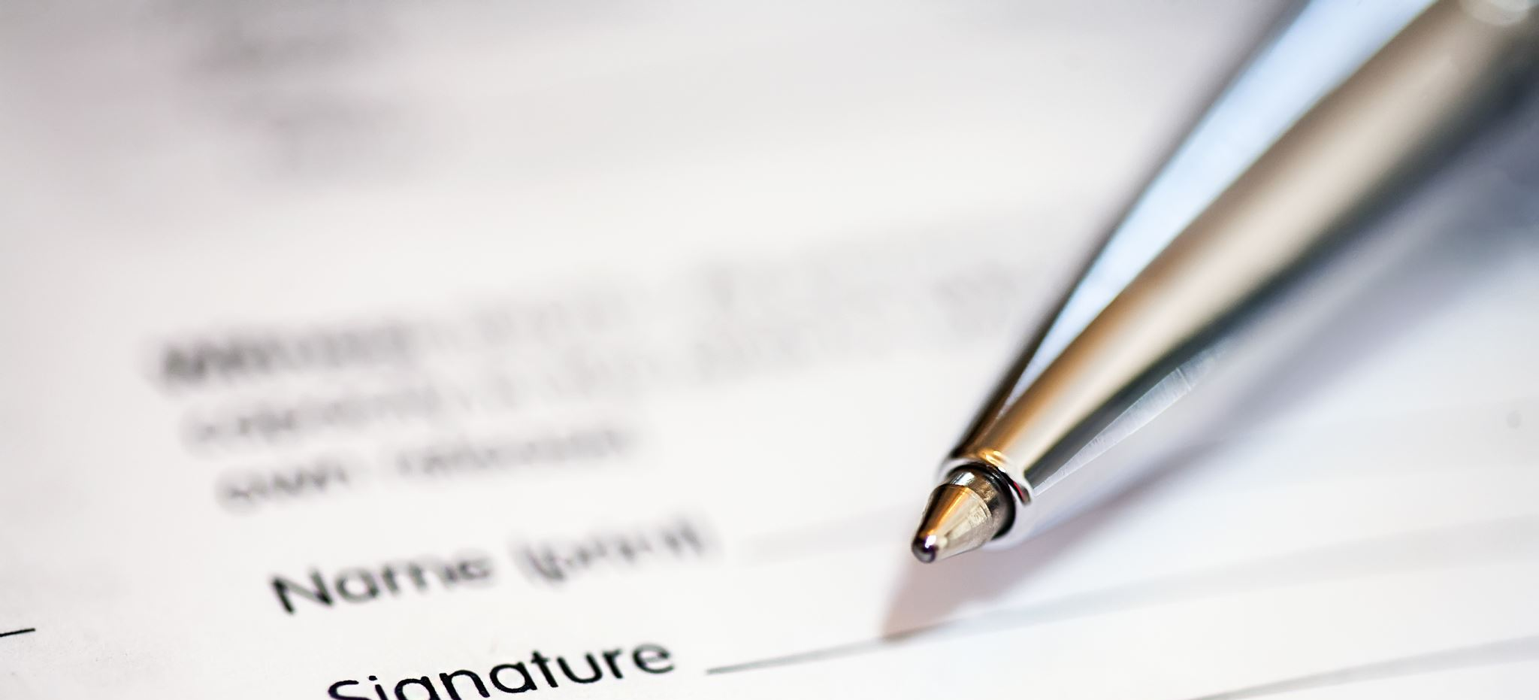
Conclusion

